Slide 1
NVIDIA’s Brev Platform
Develop with the latest NVIDIA GPUs and Software

Slide 2
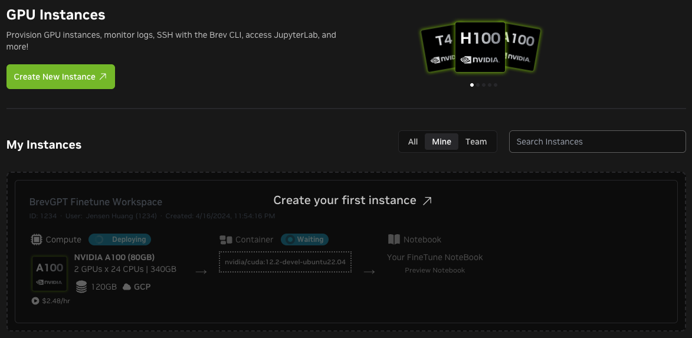
Introduction to Brev
Your starting point for AI development and experimentation
NVIDIA’s Brev platform simplifies AI development by aggregating multiple cloud providers to deliver the right NVIDIA GPUs and environments. Developers can quickly launch and customize GPU-backed setups without complex infrastructure management.
Instant GPU access: On-demand, high-performance NVIDIA GPUs provisioned instantly through our Partners. Virtual Machines preconfigured with Python, CUDA, Docker, and Jupyter Notebooks
Launchables: One-click, customizable GPU environments for faster onboarding and team consistency across projects
CLI & IDE Support: Access via Brev CLI and integrate with Cursor, Windsurf, VS Code, and tmux

Slide 3








Access to Leading Cloud Providers and NVIDIA GPUs
Constantly Growing…
NVIDIA’s Brev connects you to a worldwide NVIDIA Cloud Partner network, delivering cutting-edge GPUs on demand for AI/ML acceleration.

Slide 4
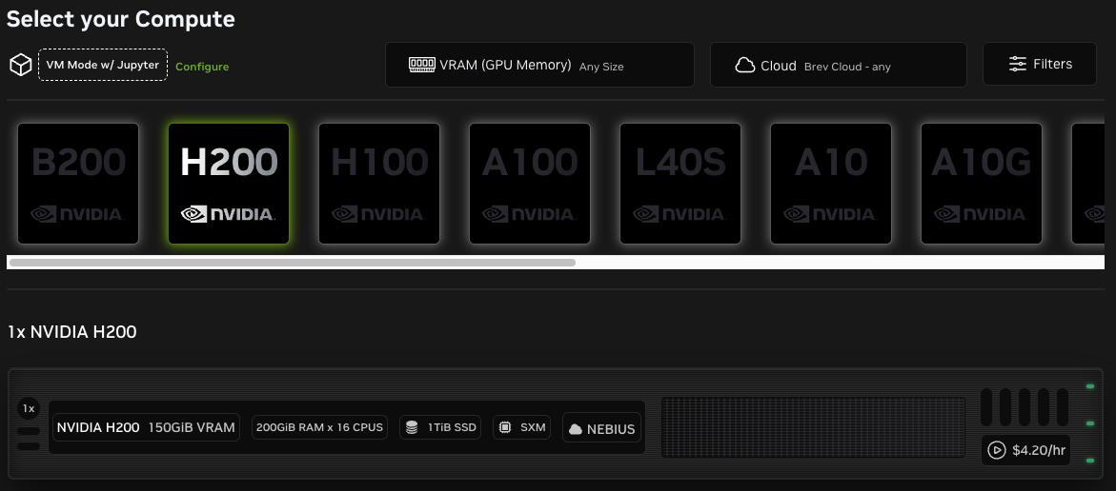
Pricing & Packaging
Self-service, pay-as-you-go GPU access for maximum flexibility
Flexible Pay-as-You-Go: Purchase credits to access on-demand GPU compute, ensuring cost-efficiency with no long-term commitments.
Transparent Hourly Rates: Clear pricing per GPU instance type, aggregated from our Partners

Slide 5
NVIDIA Launchables
A one-click experience — no setup, just code running on NVIDIA’s Accelerated Computing stack. It’s a frictionless way to show, share, and scale innovation.

Slide 6
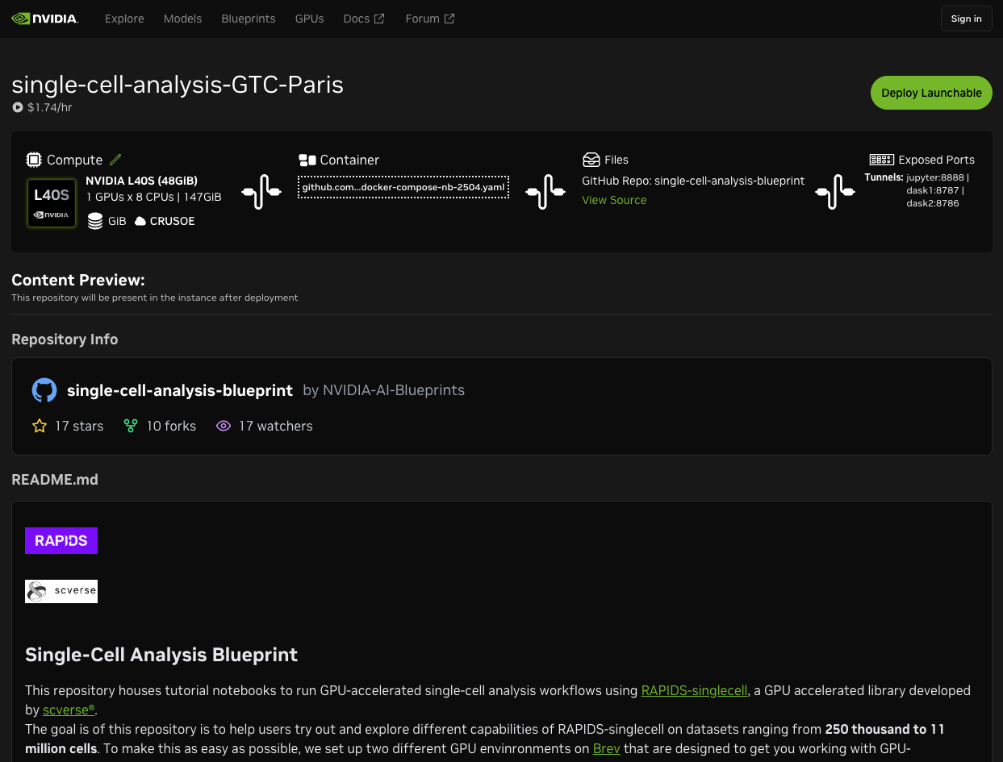
Launchables
1-click deployments for pre-configured software and hardware combinations
Software is pre-configured
Price
Predefined Compute
Content Preview

Slide 7
Create Account
Create Org
Redeem Coupon (if there is one)
Invite Users
2 ways to start:
1-Click Deploy with Launchables
Create an instance from scratch
Walkthrough+Demo

Slide 8
Happy Coding!
Brev Docs & Guides: https://docs.nvidia.com/brev/latest/about-brev.html
GPU Catalog: build.nvidia.com/gpu
Platform or Technical Support: brev-support@nvidia.com

